Slide 1
Amazon Rainforest Wildfires
By: Harsha, Mit, Roysten, Tchamy

Slide 2
Outline:
Introduction & Background
Objectives & Data Description
Data Analysis & Time Series Models
Results
Conclusions & Outlook

Slide 3
Introduction

Slide 4
Where is the Amazon?
Rutgers
Amazon

Slide 5
Amazon Rainforest:
Largest remaining rainforest which spans over 1.4 billion acres and 10 countries
One in ten species lives in Amazon
Link between the health of Amazon and health of the planet
Over 30 million people live and depend on the forest
Notes:
Half of the world’s remaining tropical forests
Texas only 170 million acres and Alaska 425 acres
Absorbs 90-140 billion metric tons of carbon which could be catastrophic if released

Slide 6
Wildfires:
Combination of natural and human caused fires
Locals start fires for farming and agriculture
Natural causes include lightning strikes and extreme dry seasons

Slide 7
Objective
&
Data Description

Slide 8

Objective:
Is there an increasing trend of forest fires which might be traced back to climate change and/or human caused fires?
Can we accurately predict forest fires?

Slide 9
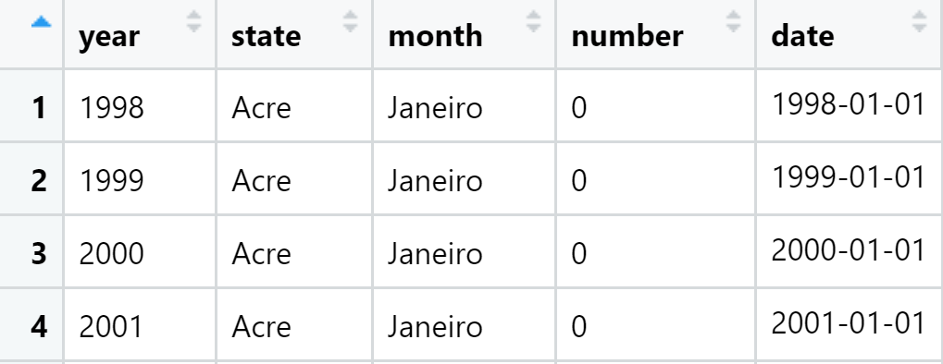
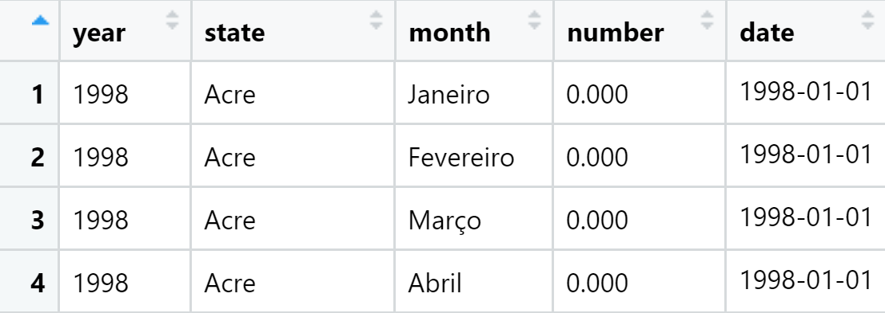
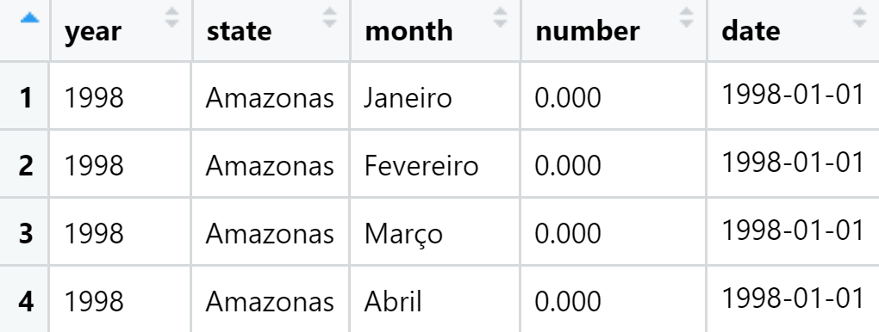
Data Description

Slide 10
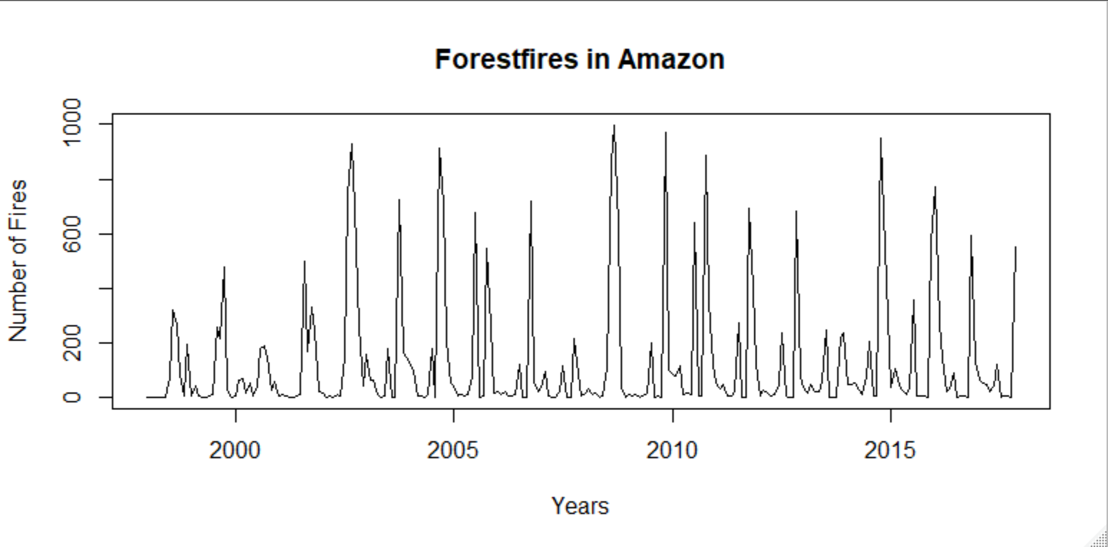
Original Data Plot

Slide 11
Data Analysis
&
Time Series Models

Slide 12
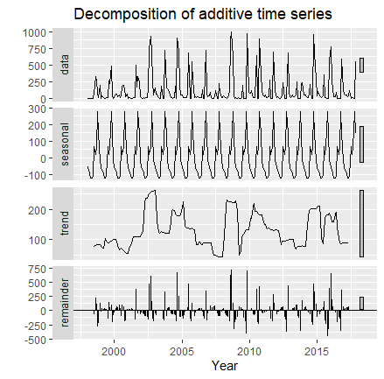
Notes:
Can clearly see SEASONALITY, no Trend.

Slide 13
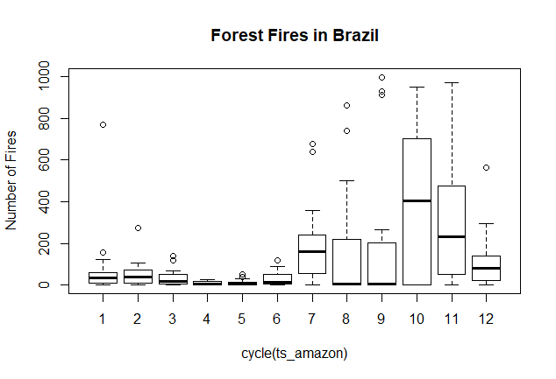
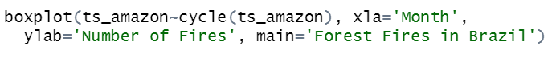

Slide 14
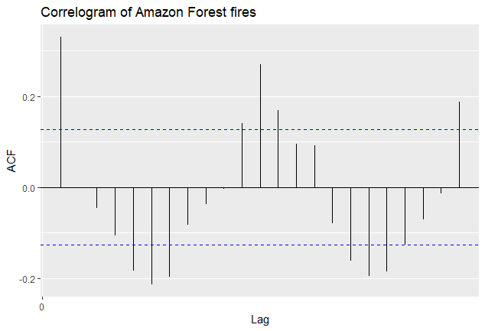
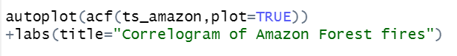

Slide 15
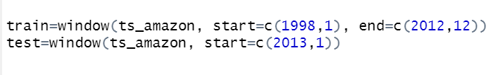
Training and Test data set
Fit a model by using TRAINING DATA.
Test the model with TESTING DATA.
The test set is not be used for any aspect of model development or calculation of forecasts.
Testing data can be used to measure how well the model is likely to forecast on new data.

Slide 16
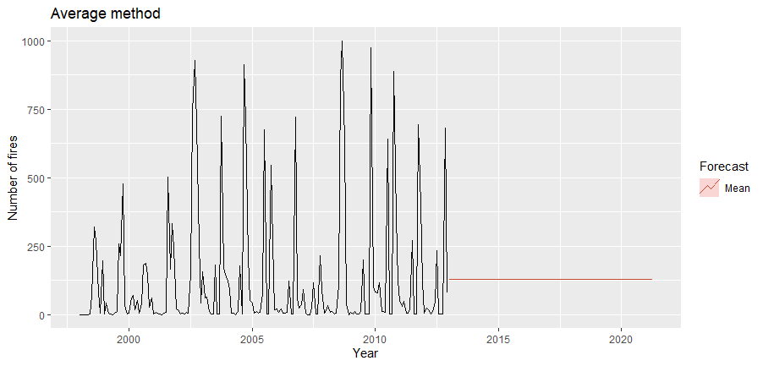
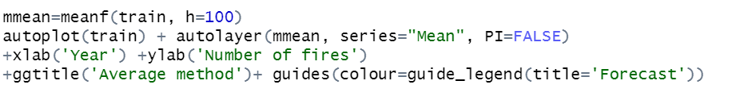
Notes:
All values average assigned to next forecasts

Slide 17
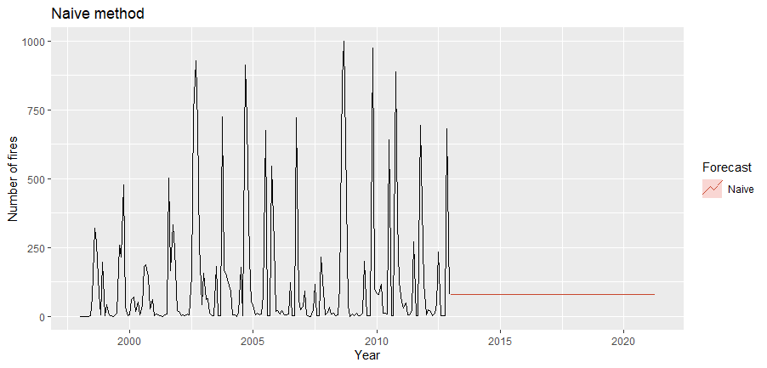
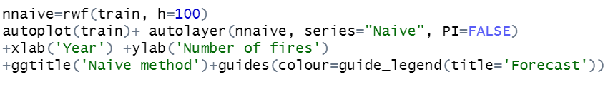
Notes:
All forecasts are set to last value of observation

Slide 18
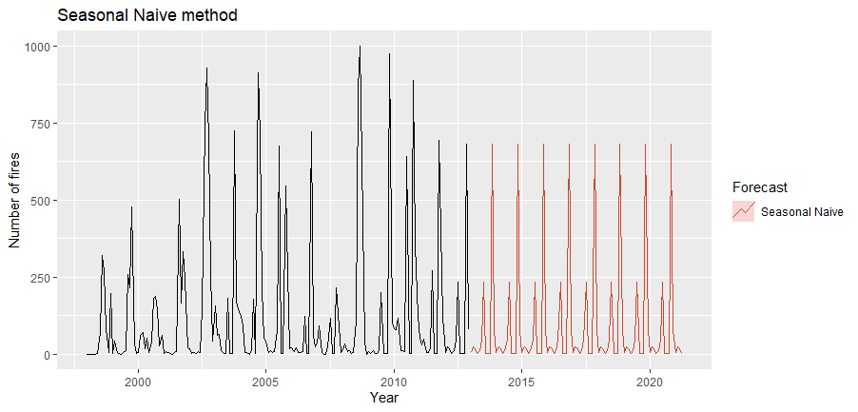
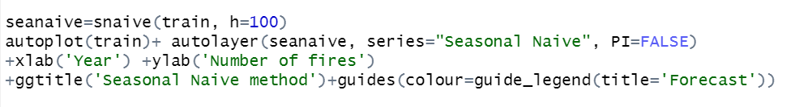
Notes:
Last observed value from same time last each year.
So 2013 jan will get value of 2012 jan.

Slide 19
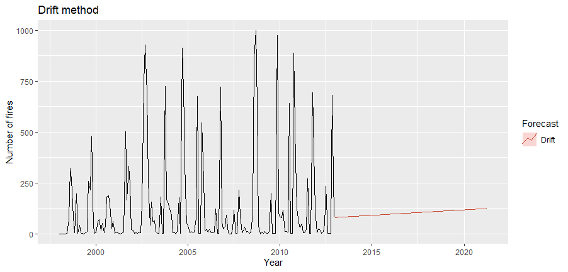
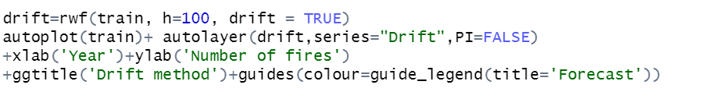
Notes:
Adds the amount of change over the period of time

Slide 20
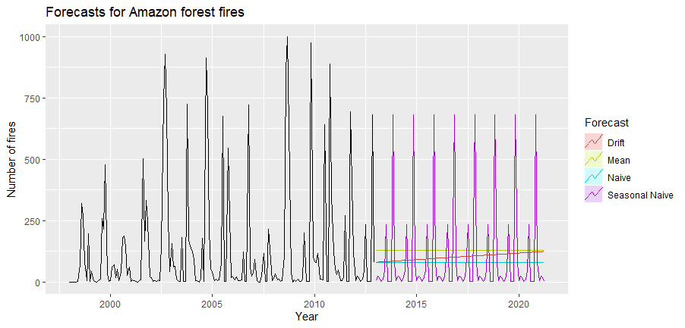
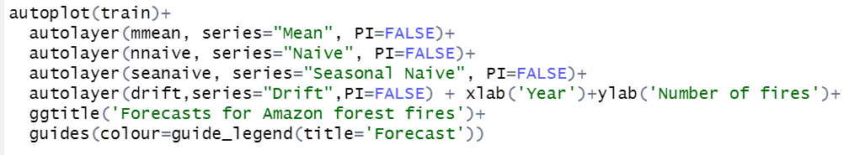

Slide 21
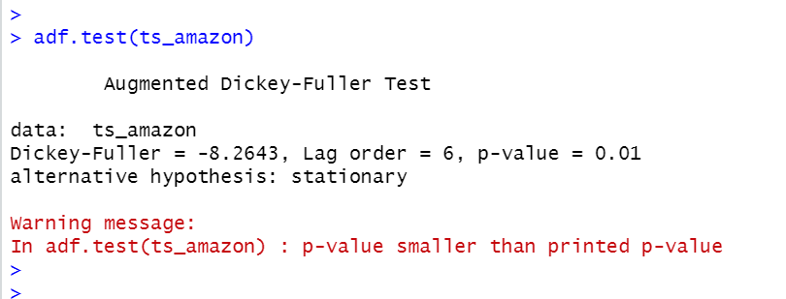
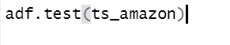
Check for Stationarity: ADF Test
Notes:
P-value is not greater than 0.01 (1%)
So we reject our null hypothesis of not stationarity.
Means our data is stationary

Slide 22
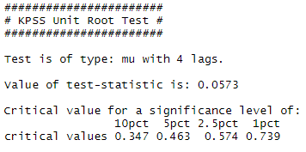
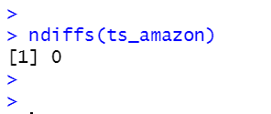
Check for Stationarity:
KPSS Test
No further differencing necessary
Test-statistic is below the critical values
P-Value is 0.1, so bigger than 0.05
The null hypothesis is not rejected. The data is stationary
The ndiffs function
Notes:
summary(Ur.kpss(table_name)) to calculate the test statistic
10 pct means 90% Confidence Interval
Test statistic < critical values
stationary

Slide 23
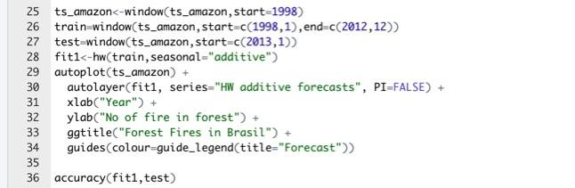
Holts Winter
Holt-Winters forecasting is a way to model and predict the behavior of a sequence of values over time—a time series.
Holt-Winters uses exponential smoothing to encode lots of values from the past and use them to predict “typical” values for the present and future.
Notes:
1.Holt’s winter method is used in our case because we have seasonal data.
2. Also we are using additive method because additive methods are used when we have roughly constant seasonality over the levels (our data has roughly constant seasonality). Multiplicative is used when there is proportional changes in seasonality according to levels.

Slide 24
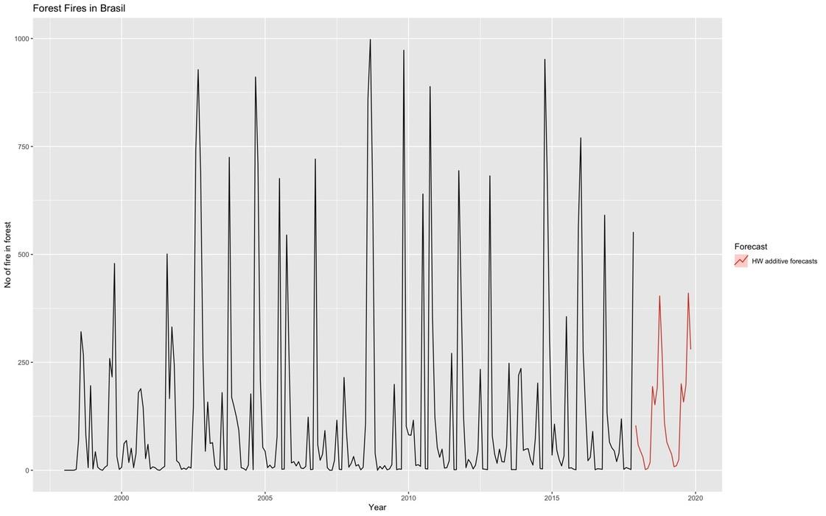
Notes:
3.Forecast=estimated data point + trend + seasonality ( (*) when we use multiplicative)

Slide 25
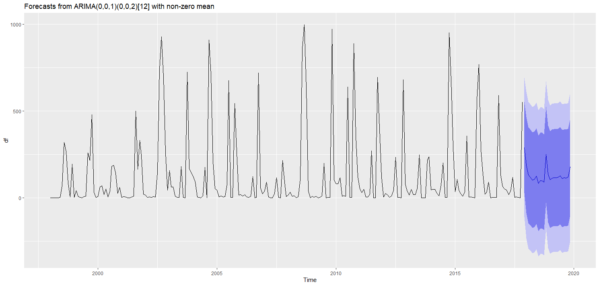
Prediction Using Arima Models
Notes:
(P, D, Q )— represents the (p,d,q) for the seasonal part of the time series
MA models are used when seasonal auto-correlation is negative
A purely MA model would smooth out these sudden jumps like the exponential smoothing method.

Slide 26
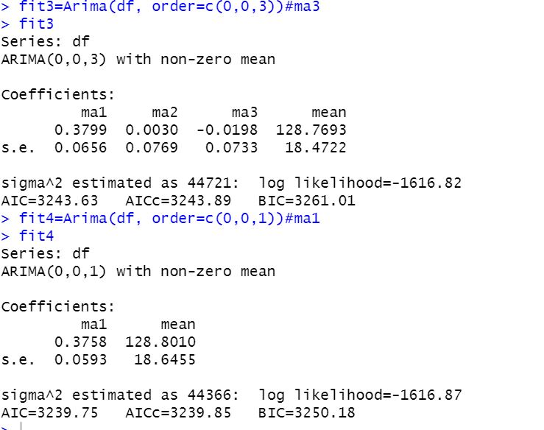

Slide 27
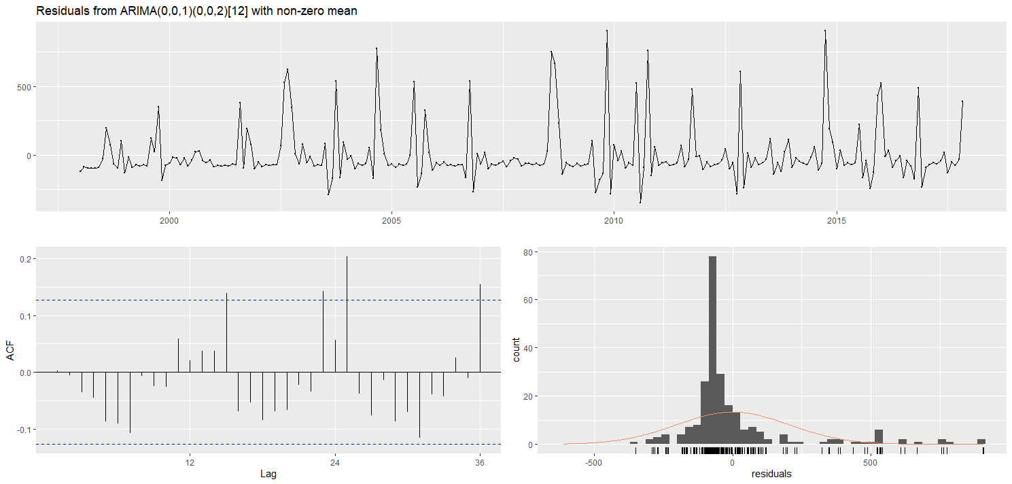
Prediction Using Arima Models
Notes:
Not highly corellated as we can see from the residuals plot also that it is almost normally dist but not deviated well
It satisfies the condition that lag 1 should be negatively correlated
Should drop sharply after a few lags
Pacf decreases more gradually

Slide 28
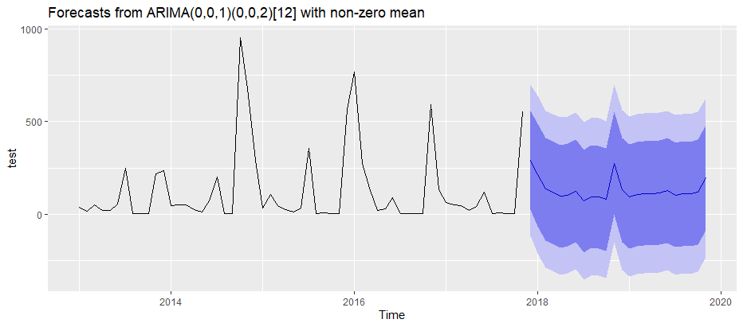
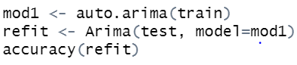

Slide 29
Results

Slide 30
Results
 | ME | RMSE | MAE | MPE | MAPE | MASE | ACF1
Mean | -2.64099 | 209.6713 | 147.5756 | -1856.599 | 1884.944 | 1.153397 | 0.3450028
Naive | 46.2541864 | 214.6963 | 126.1187 | -1114.382 | 1153.637 | 0.985697 | 0.3450028
Snaive | 33.488000 | 215.1044 | 97.63234 | -1606.367 | 1694.964 | 0.76305 | 0.0409
Drift | 3.284637e+01 | 211.9786 | 131.1125 | -1332.529 | 1368.041 | 1.024728 | 0.3461225
Holt’s Winter | 26.35708 | 200.8795 | 135.6110 | -3243.767 | 3382.392 | 1.059886 | 0.4363718
ARIMA | 1.593283 | 193.7305 | 125.3166 | -1754.817 | 1780.38 | 0.804345 | 0.1262206

Slide 31
Conclusion
&
Outlook

Slide 32
Conclusion
No trend observable
Data only up to 2017
Data is seasonal and allows us to make forecasts
With those predictions locals can be helped to better plan

Slide 33
Resources:
https://www.worldwildlife.org/places/amazon
https://www.dosomething.org/us/facts/11-facts-about-wildfires
https://towardsdatascience.com/time-series-forecasting-arima-models-7f221e9eee06

Slide 34
Thank you!
Q&A

